Slide 1
Weekly meeting 8
Shengya Guo, CR/AVS3, 21.08.2024

Slide 2
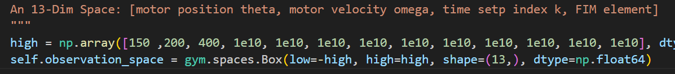
The observation space
Train the RL with all infomation in Observation
The observation space have 13 dimensional:
Motor position, motor velocity, time setp index (3)
upper triangular FIM elements (10)
The scaled FIM is not meaningful for the training of RL, because every time step we have a new scale factor and the elements of the scaled FIM is not comparable
The meaning of scaled FIM is to calculate the reward without overflow problem, so for the reward calculation, this part is still needed

Slide 3
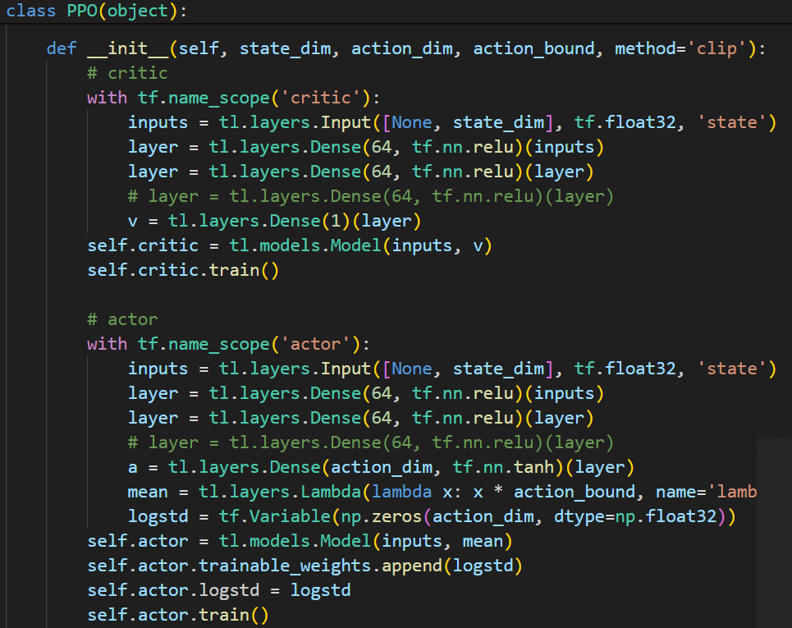
A self-built PPO structure
2 Dense layer with 64 neurons in actor and critic.

Slide 4
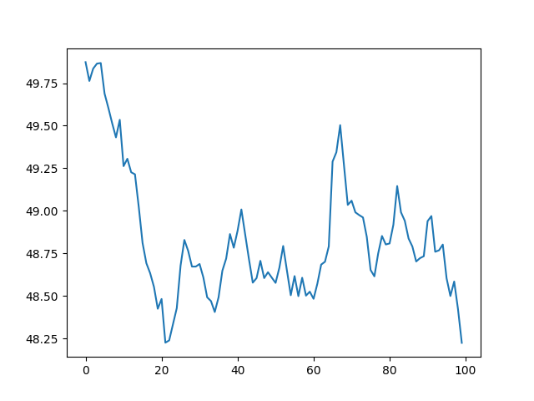
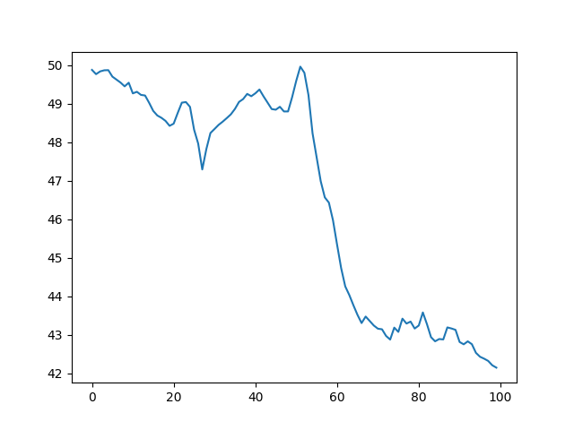
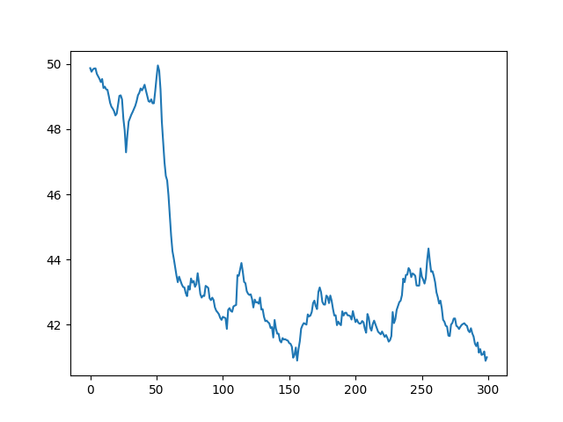
Performance
ppo-clip parameters：0.25, 0.2, 0.2

Slide 5
Drawback
The old version code do 64 step to data collection, and then one time update, discard the buffer, do 64 step data again.
So in 300 step, there will be only 300/64=4 time update.

Slide 6
Drawback
Because each element in the observation space is really different in value, so the observation space normalization is necessary.
By running the RL, the velocity in observation space could run over the maximal value. There are two way, first is clip the velocity in step(), which was used for example in gym.pendulum, another way is punish it in the reward function.
The punishment in reward, could think about if v > max.v, really big minus reward and restart. Or from some v, there will be continue minus reward if the v still getting bigger

Slide 7
Vectorized architecture
In this architecture, PPO first initializes a vectorized environment envs that runs N
(usually independent) environments either sequentially or in parallel by leveraging multi-processes. envs presents a synchronous interface that always outputs a batch of N observations from N environments, and it takes a batch of N actions to step the N environments.

Slide 8
Next
See if normalize wrapper will let it loose meaning. Maybe normalize with maximal value
Test if it could learn sth just with one parameter, ex viscos para in maxi speed
Position use distance punishment, velocity use suddenly dead

